Slide 1

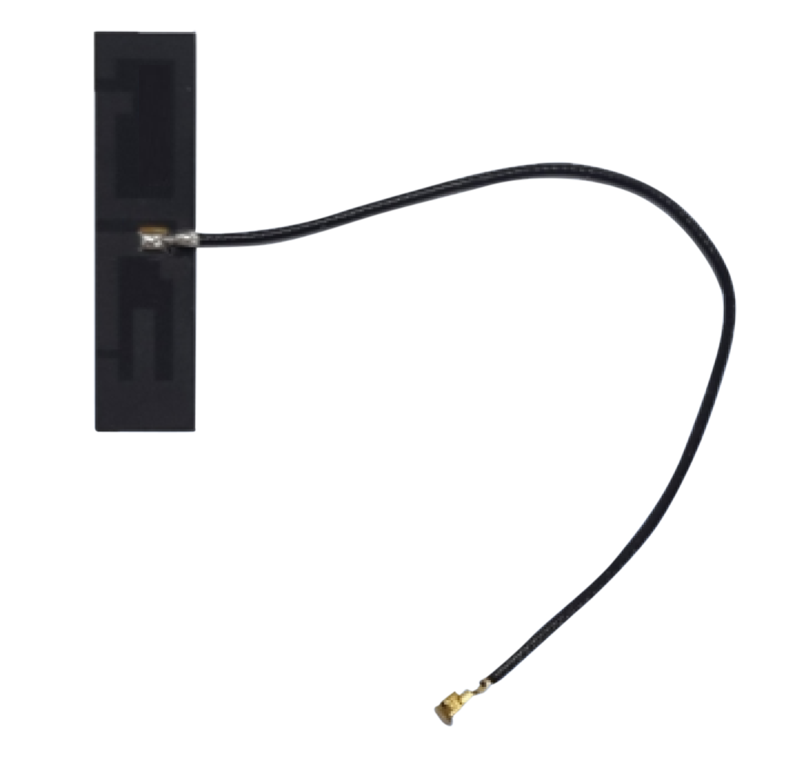
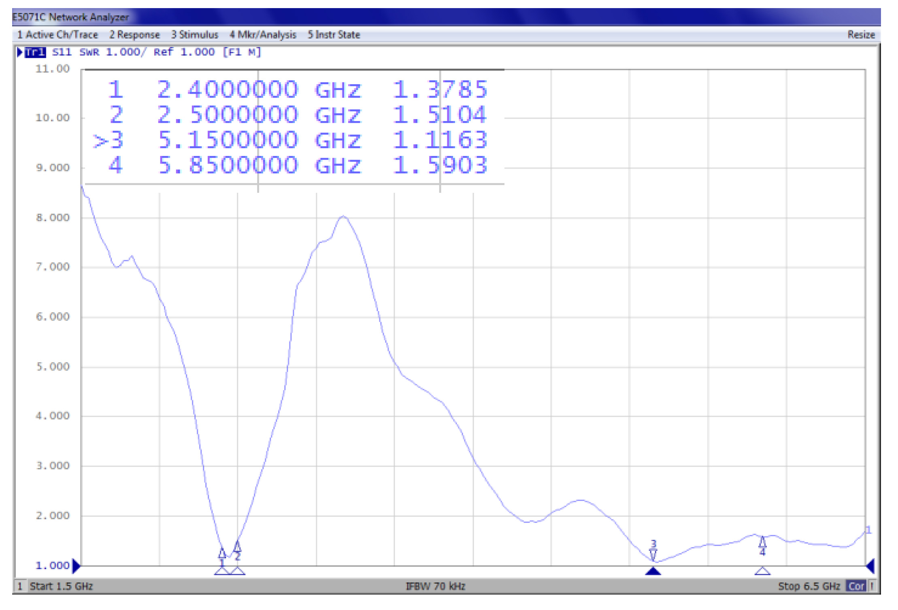
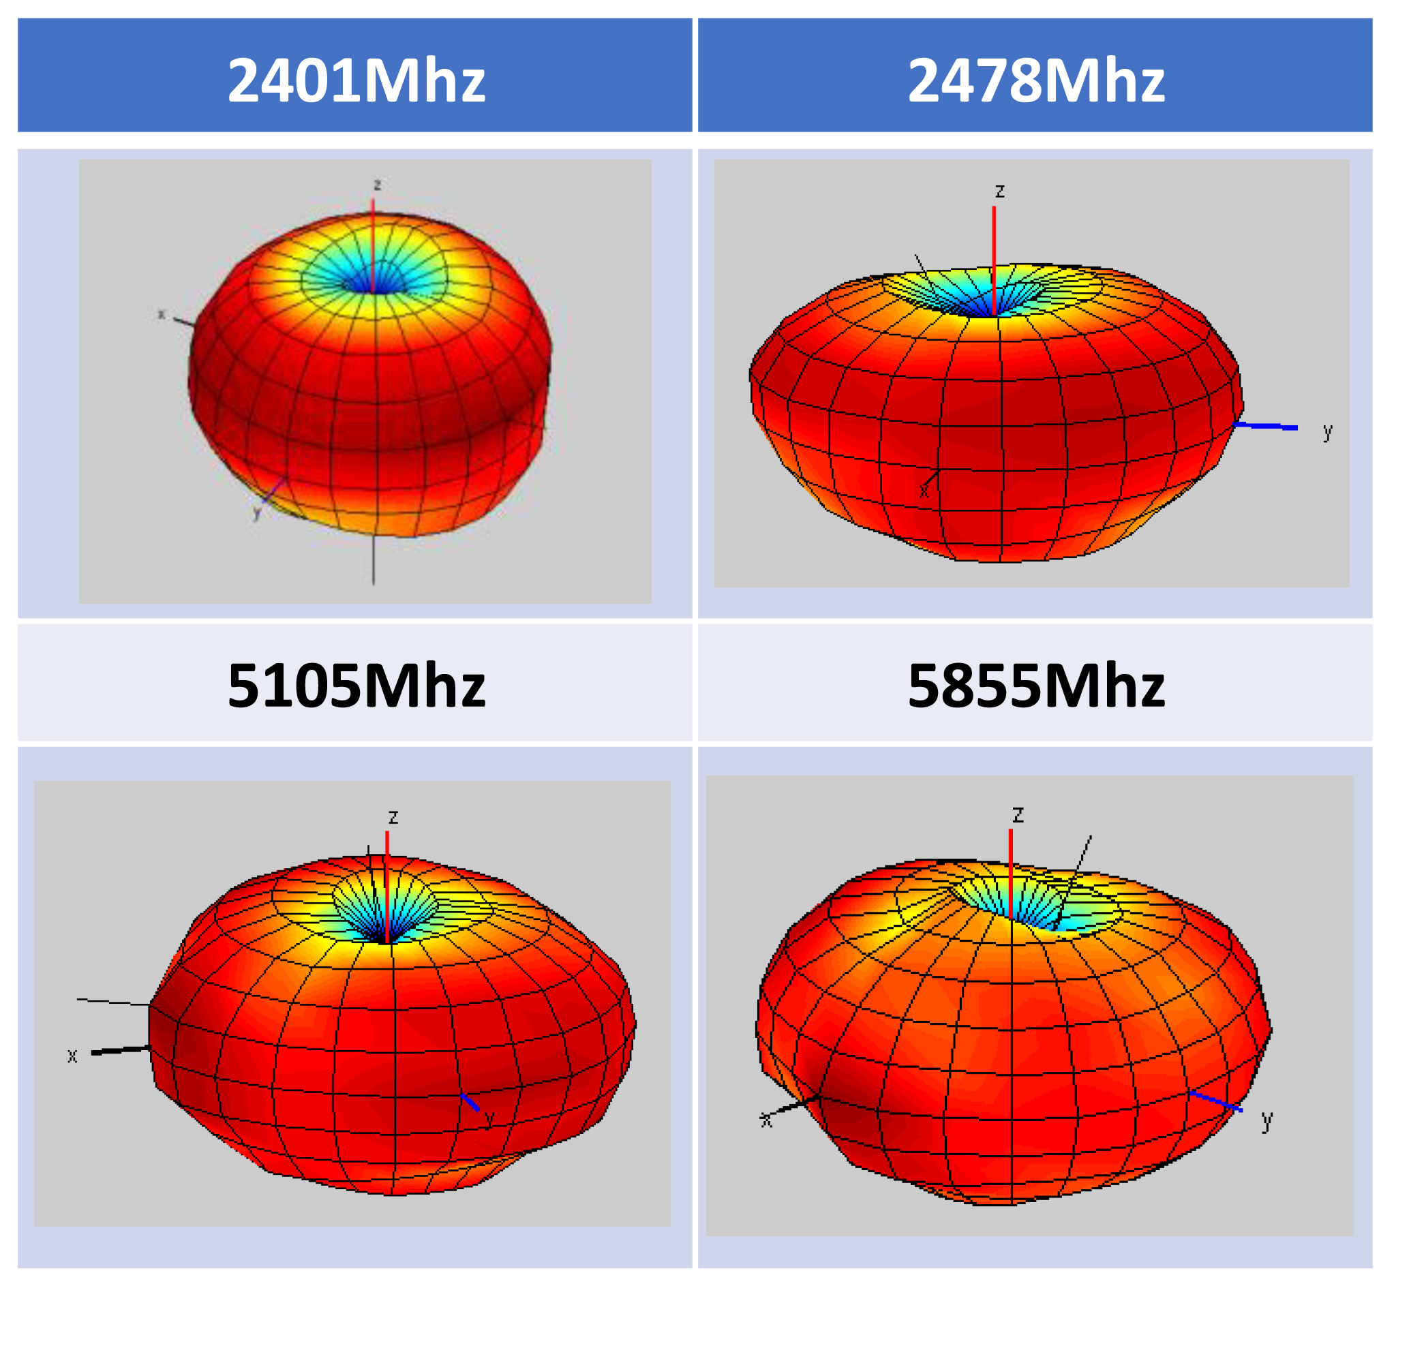
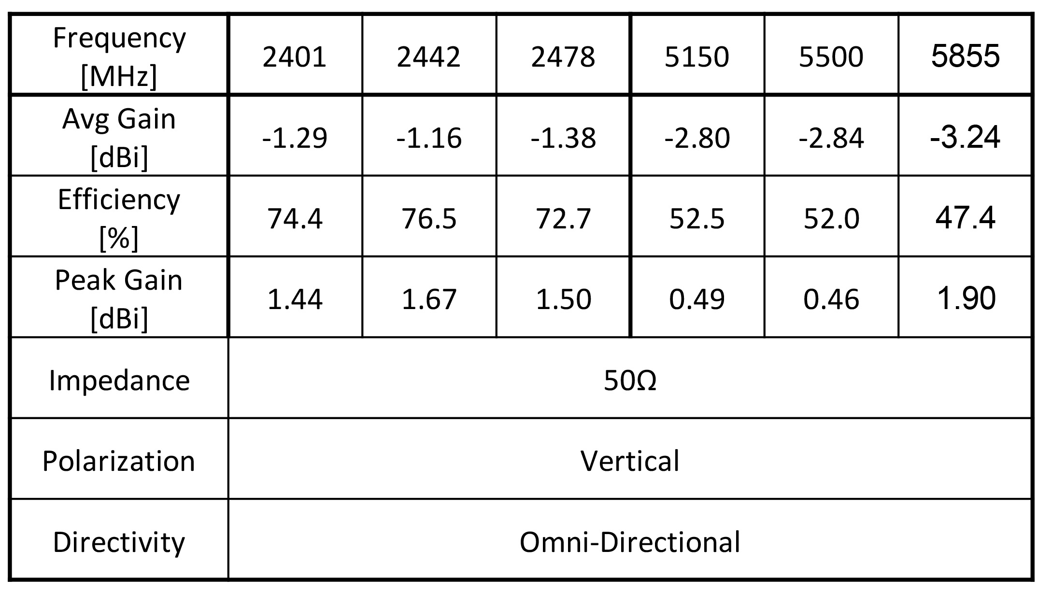
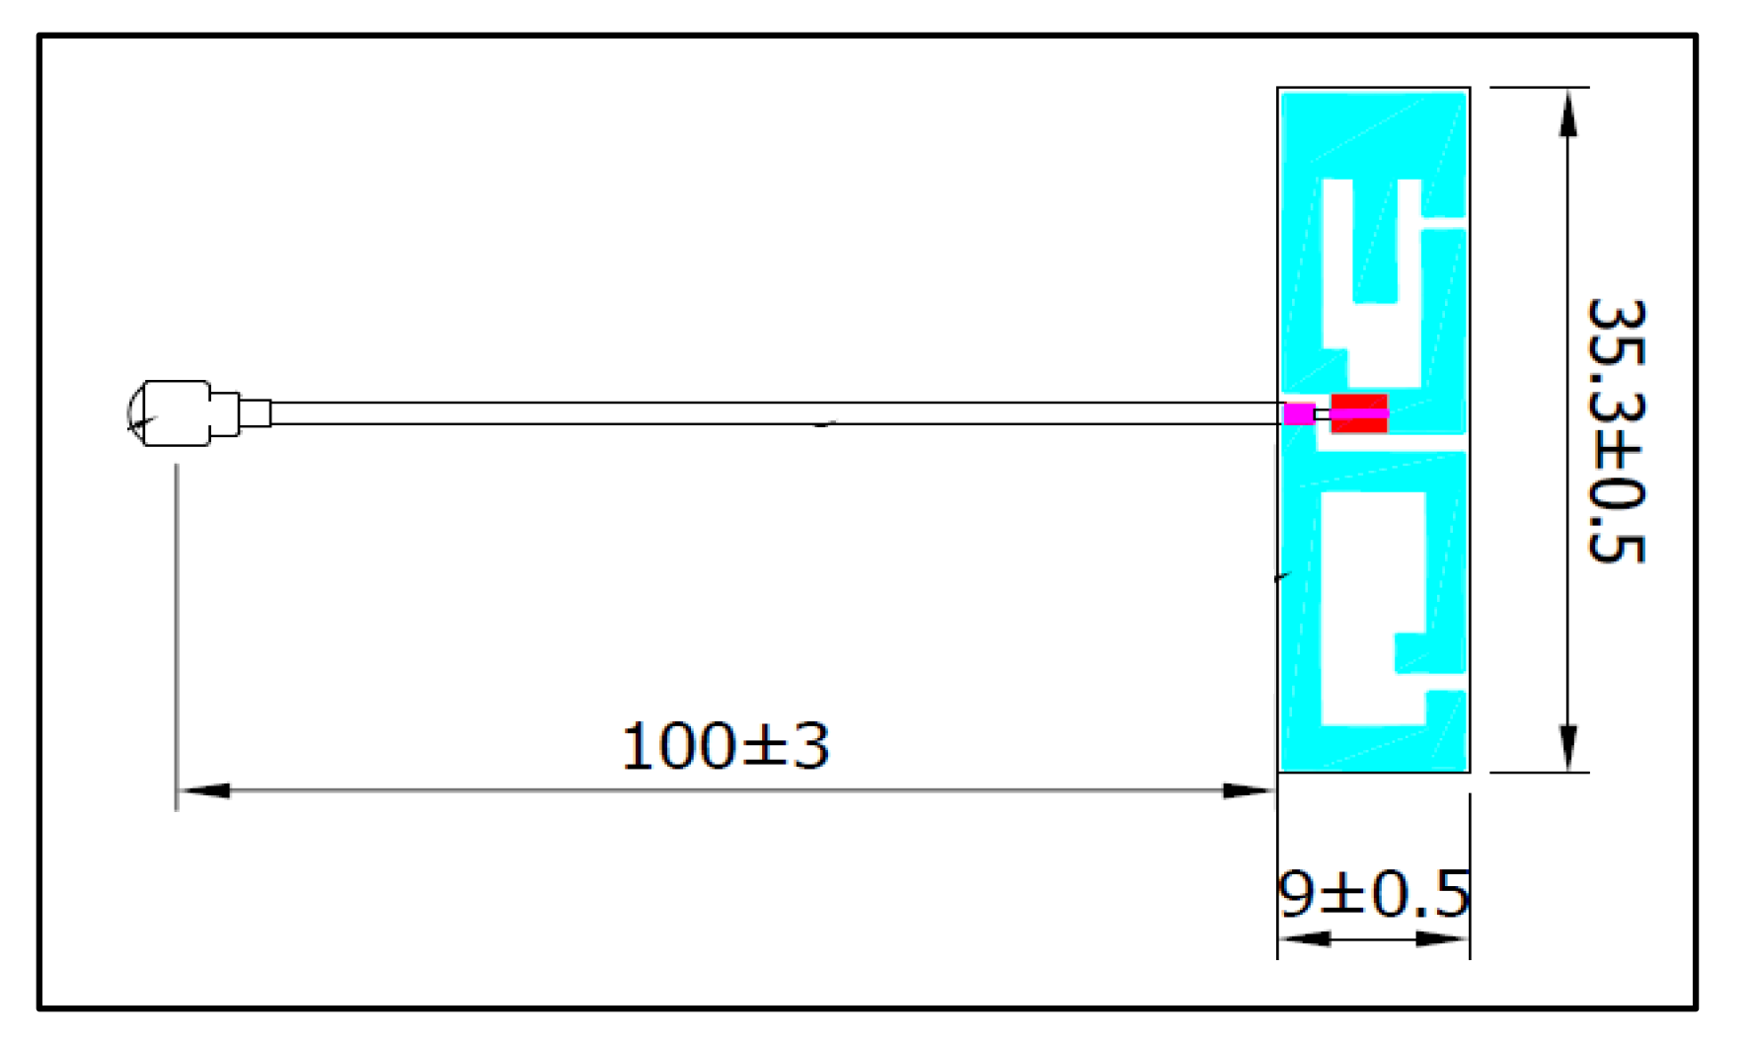

W-Fi Dual Band Antenna
TAEP121 Wi-Fi Dual Band Omni Antenna
Features and Benefits
INTRODUCTION
The TAEP121 is an omnidirectional Wi-Fi dual band antenna used to connect wireless communication devices such as laptop computers, printers, and cameras etc. to the Wi-Fi router.
Antenna Size : 35.3 x 9mm (FPC)
Connector : MHF1 (or MHF4) plug
Coaxial Cable : Φ1.13 x 100mm (Length is customizable)
Operating Frequency Bands: – 2400~2500Mhz – 5100~5900MhzFerrite Core
High Efficiency
RoHS Compliance
APPLICATION
Example Uses – laptop computers, printers, and cameras etc.
Performance
VSWR
Radiation Pattern
Specifications
Dimension (unit : mm)
www.skymirr.com
U S +1-321-393-1039 sales@skymirr.com
K R carl.lee@skymirr.com
TW christin.lin@skymirr.com
PAGE 1

